Slide 1
Lesson 2
Spring Data
Tapping the Source of Pure Knowledge

Slide 2
Spring Data
Spring Data
  High level SpringSource project whose purpose is to unify and ease the access to different kinds of persistence stores, both relational database systems and NoSQL data stores.
Hibernate ORM
  (Hibernate for short) is an object-relational mapping Java library;
  a framework for mapping an object-oriented domain model to a
  traditional relational database. Distributed under the GNU Lesser General Public License
Notes:
JBOSS- Hibernate
Pivotal – Spring/Tomcat

Slide 3
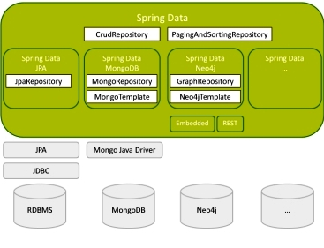
Spring Data Project
Notes:
https://en.wikipedia.org/wiki/NoSQL#Types_and_examples_of_NoSQL_databases

Slide 4
Spring Data Repositories
  Spring Data repository abstraction
  Significantly reduce the amount of boilerplate code required to implement data access layers
  Domain Object specific wrapper that provides capabilities on top of EntityManager
  Performs function of a Base Class DAO
Three Types:
CrudRepository provides CRUD functions .
PagingAndSortingRepository provide methods to
do pagination and sorting records.
JpaRepository provides methods such as flushing
the persistence context and delete record in a batch .

Slide 5
CrudRepository
public interface CrudRepository<T, ID extends Serializable> extends Repository<T, ID> {
<S extends T> S save(S entity);
T findOne(ID primaryKey);
Iterable<T> findAll();
Long count();
void delete(T entity);
boolean exists(ID primaryKey);
}
LOOKS just Like [what is Known as] a “generic DAO interface”
HOWEVER, Spring provides [default] implementations – effectively Java 8-like default methods in an interface
JPA CrudRepository Save/Update
public <S extends T> S save(S entity) {
if (entityInformation.isNew(entity)) {
em.persist(entity);
return entity; }
else {
return em.merge(entity);
}
Notes:
Save backed by merge

Slide 6
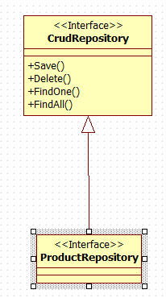
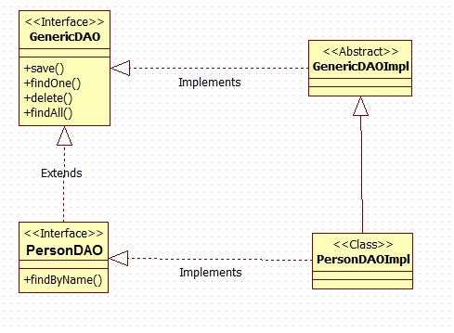
“Classic” ORM GenericDAO
Spring Data
Generic types
Adds Domain Object specific functionality
Notes:
SPRING DATA == ProductDAO Interface

Slide 7
Spring Version of DAO
@Service
@Transactional
public class ProductServiceImpl implements ProductService {
@Autowired
ProductRepository productRepository; // “ProductDAOImpl”
public void createProduct(Product product) {
productRepository.save(product );
}
ProductDAOImpl
@Repository
public interface ProductRepository extends CrudRepository<Product, Long> { }
“Automatically” creates CRUD services

Slide 8
Spring Data Repository Query Resolution
Query examples
CREATE example
Employee findById(long id);
  USE DECLARED QUERY example
@Query("SELECT e FROM Employee e where EMP_ID = :id")
Employee findById(@Param("id") long id);
Use class level declared query EXAMPLE
public static final String FIND_BY_ID_QUERY = "select e from
Employee e where EMP_ID = :id";
@Query(FIND_BY_ID_QUERY)
Employee findById(@Param("id") long id);
Notes:
Criteria API & QueryDsl
https://spring.io/blog/2011/04/26/advanced-spring-data-jpa-specifications-and-querydsl/

